Slide 1
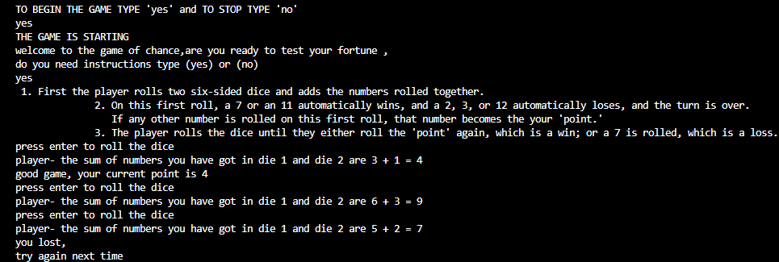
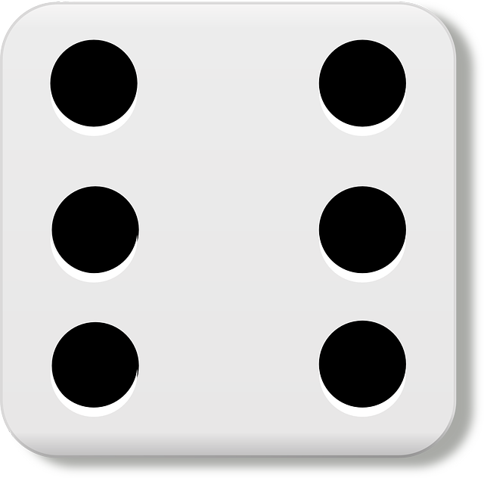
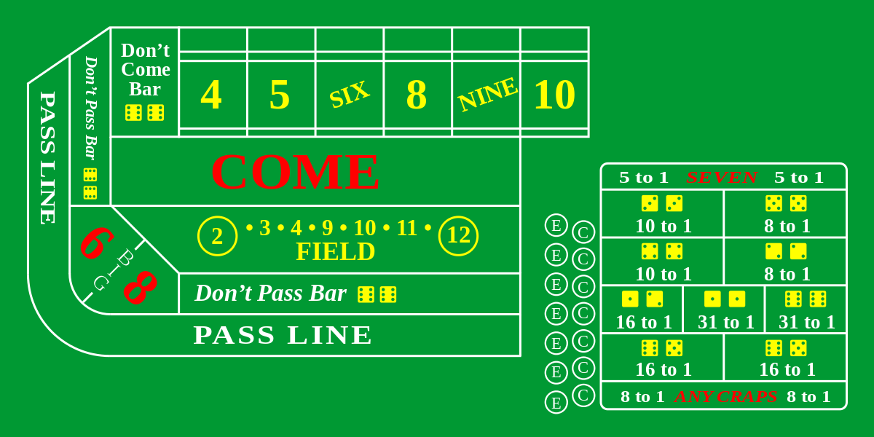
‘Dice Game’ By Will Bowden
This is a game of dice with one or more players where a random number for a dice roll is generated. The game will be able to be played by anyone. The game will be able to give instructions on how to play a craps game and it will run the game with 2 dice and roll until the user wins or loses. The game goes for as many rounds as the user would like.
Preparation
Game begins
Results are determined
The user is asked if they ready to play and if they need directions on how to play
The user rolls the dice by pressing enter and is given a ‘point’. If a 7 or 11 is rolled and loses if a 2,3, or 12 is rolled
The turn keeps going until the user rolls a 7 in which case they lose, or they roll their ‘point’ in which case they win
“A competitive game for all”
wbowden3/Dice_Game-1: Dice game simulator (github.com)

